Slide 1
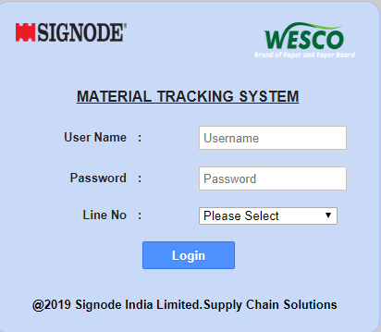
MTS-WCPM
Login Page

Slide 2
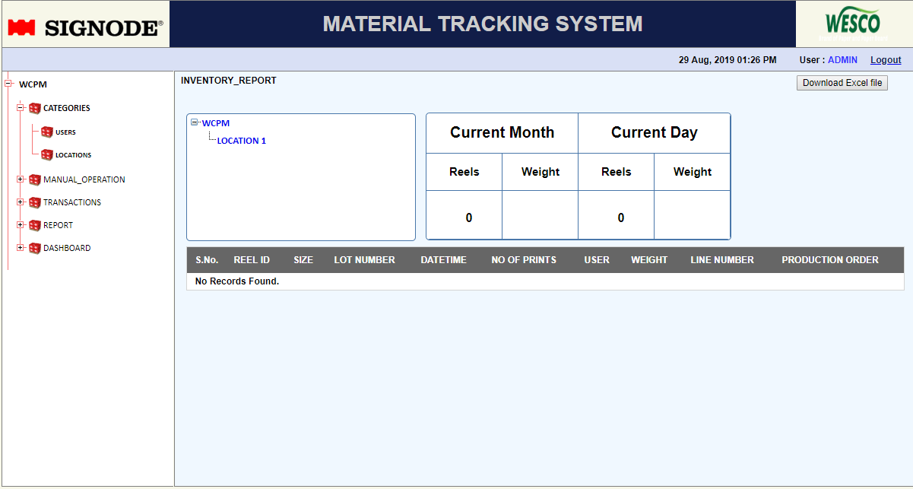
Dashboard
Download excel file Option

Slide 3
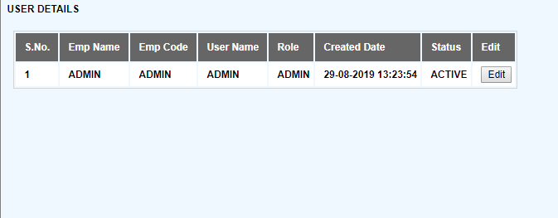
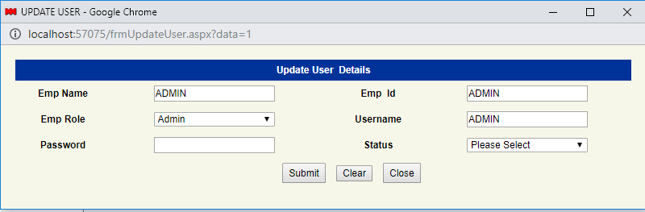
User
Edit User Option
Update User details screen

Slide 4
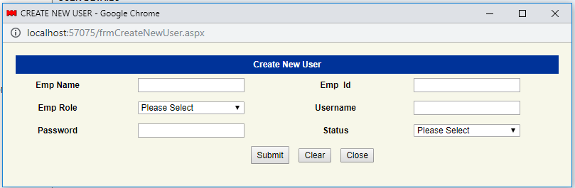
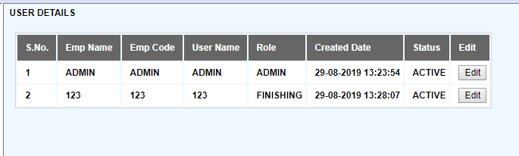
Create User Screen
User Screen after user Creation

Slide 5
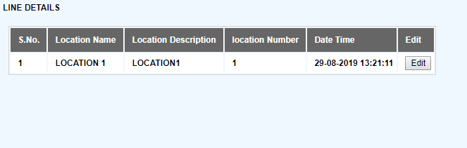
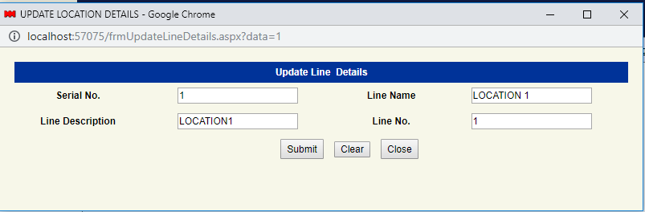
Location\Line Creation
Update Line Details Screen

Slide 6
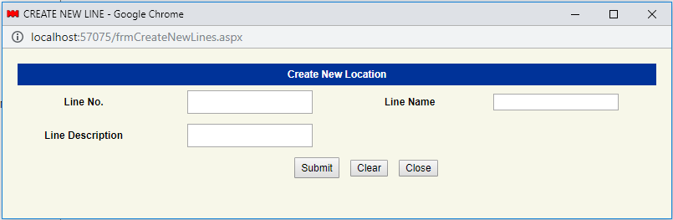
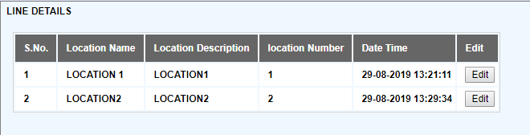
Create New location screen
Add location screen after adding new locations

Slide 7
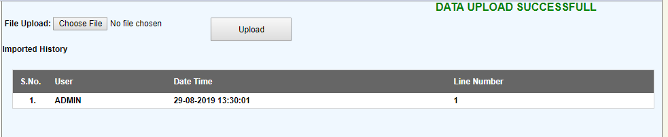
Import data from excel file

Slide 8
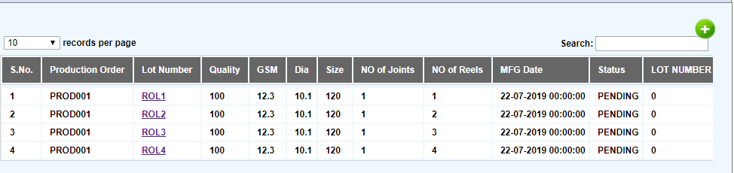
Production Order Screen
Create new Production order
Create child reels

Slide 9
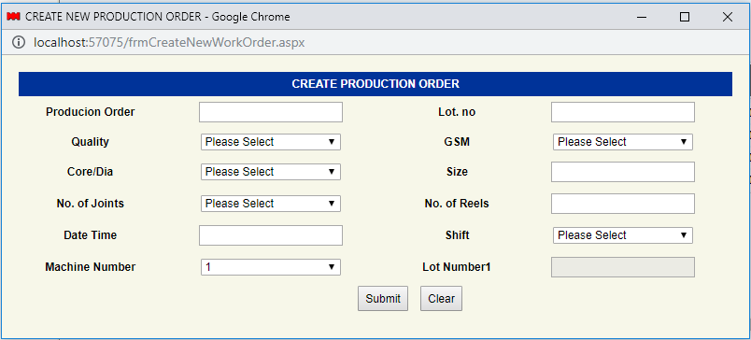
Create new Production order

Slide 10
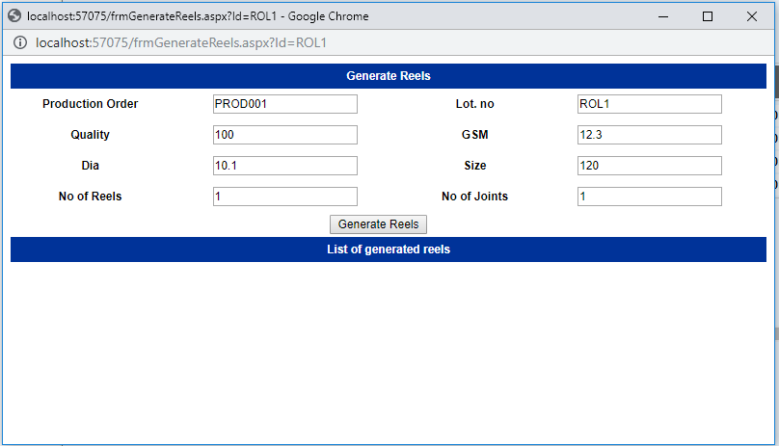
Create Child Reels

Slide 11
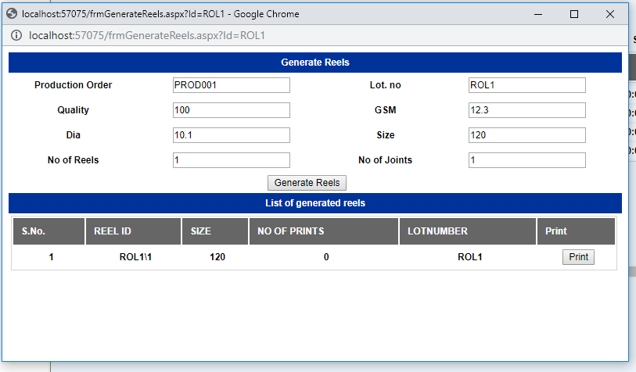
Create Child Reels(Contd..)
Reprint if no of Prints is greater than 0

Slide 12
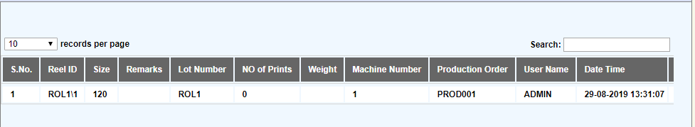
Inventory Report

Slide 13
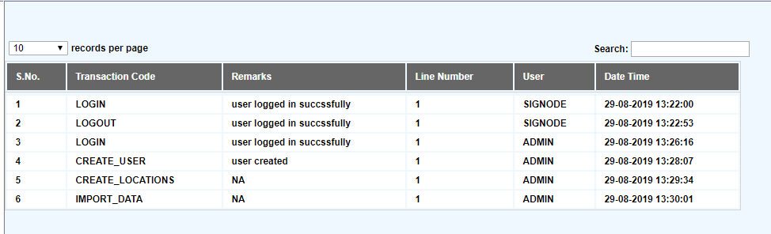
History Report

Slide 14
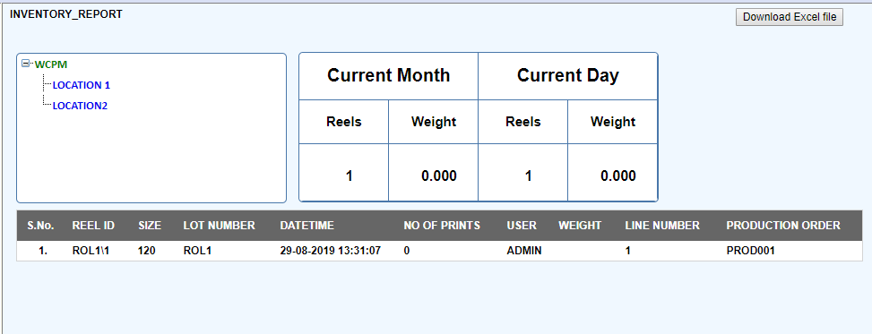
Dashboard after one transaction

